Slide 1
WELCOME TO OUR PRESENTATION
Md. Sohag Hasan
Roll No. 2110656107

Slide 2
Environmental impact assessment of teesta barrage project
Project Type: Mega Infrastructure & River Management Project
Partnership: Government of the People’s Republic of Bangladesh & Government of the People’s Republic of China (PowerChina)

Slide 3
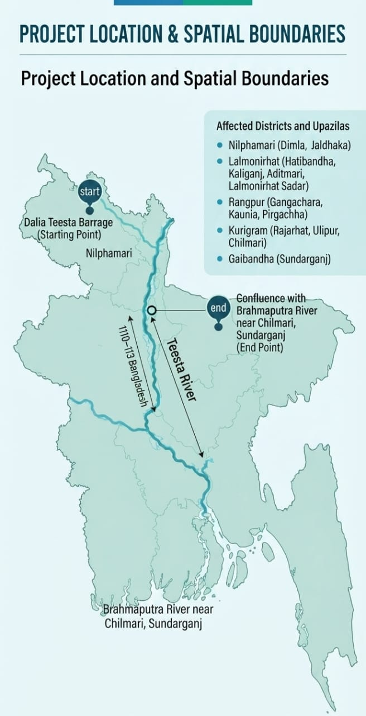
1. Project Location and Spatial Boundaries
● Geographical Coverage: Approximately 110–113 km stretch of the Teesta River within Bangladesh.
● Spatial Limits (Area of Influence):
○ Starting Point: Dalia Teesta Barrage (Border of Nilphamari and Lalmonirhat districts).
○ End Point: Confluence of the Teesta River with the Brahmaputra River at Chilmari (Kurigram) and Sundarganj (Gaibandha).
● Affected Districts and Upazilas:
○ Nilphamari: Dimla, Jaldhaka.
○ Lalmonirhat: Hatibandha, Kaliganj, Aditmari, Lalmonirhat Sadar.
○ Rangpur: Gangachara, Kaunia, Pirgachha.
○ Kurigram: Rajarhat, Ulipur, Chilmari.
○ Gaibandha: Sundarganj.

Slide 4
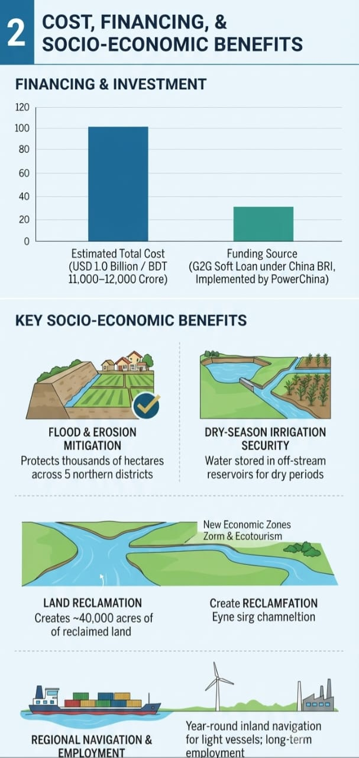
2. Cost, Financing, and Socio-Economic Benefits
● Estimated Cost & Funding: Estimated at USD 1.0 Billion (approx. BDT 11,000–12,000 Crore). Proposed to be funded under a G2G Concessional Soft Loan framework within China's Belt and Road Initiative (BRI), implemented by PowerChina.
● Key Socio-Economic Benefits:
1. Flood & Erosion Mitigation: Protects thousands of hectares of arable land and settlements across 5 northern districts from annual erosion.
2. Dry-Season Irrigation Security: Water stored in off-stream reservoirs will ensure irrigation supply during dry periods.
3. Land Reclamation (170+ sq. km): Channelizing the river creates ~40,000 acres of reclaimed land for economic zones, solar parks, and eco-tourism.
4. Regional Navigation & Employment: Year-round inland navigation for light vessels and long-term employment through industrialization and modernized agriculture.

Slide 5
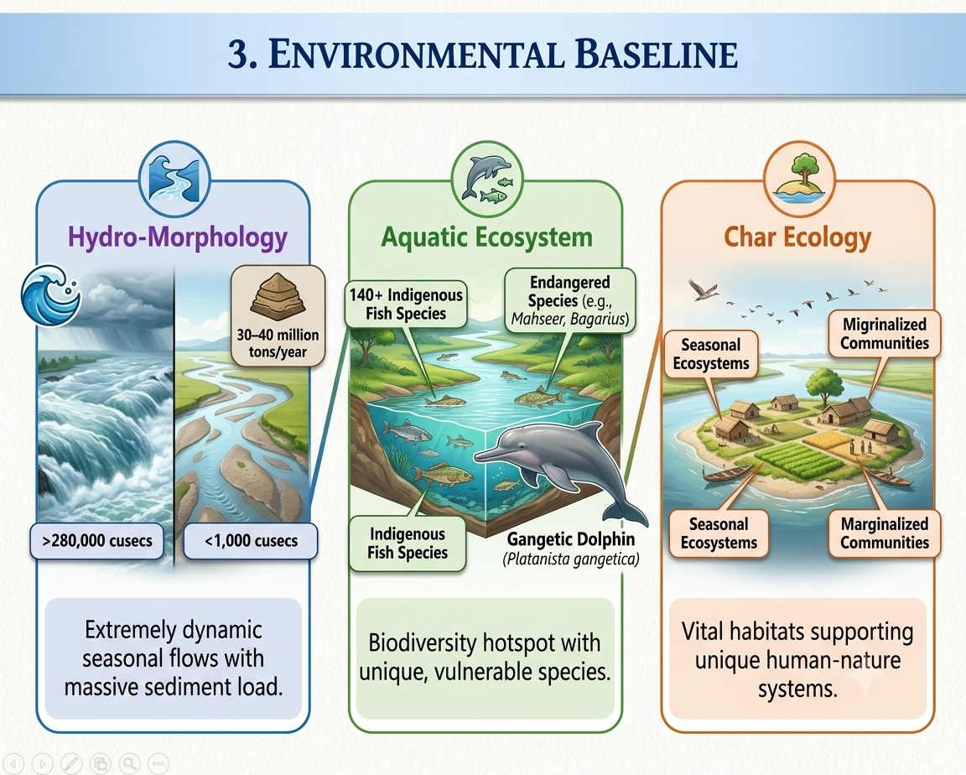
3. Environmental Baseline
● Hydro-Morphology: Extreme seasonal variation with monsoon discharges exceeding 280,000 cusecs and dry-season flows dropping below 1,000 cusecs. The river carries an annual sediment load of 30–40 million tons.
● Aquatic Ecosystem: Home to over 140 indigenous fish species, including endangered species (e.g., Mahseer, Bagarius) and aquatic mammals such as the Gangetic Dolphin (Platanista gangetica).
● Char Ecology: Temporary riverine islands (chars) support seasonal ecosystems, migratory birds, and marginalized char-dwelling agricultural communities.

Slide 6
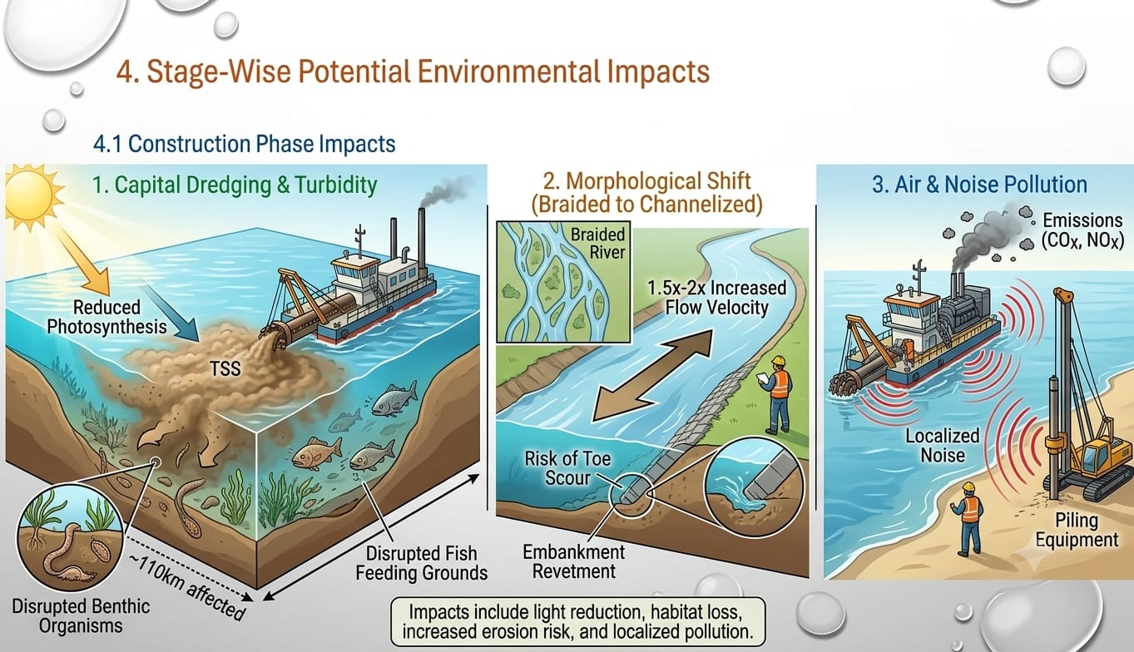
4. Stage-Wise Potential Environmental Impacts
4.1 Construction Phase Impacts
1.Capital Dredging & Turbidity: Extensive dredging over 110 km will temporarily spike Total Suspended Solids (TSS) and turbidity, disrupting photosynthesis, benthic organisms, and fish feeding grounds.
2. Morphological Shift (Braided to Channelized): Restricting a multi-channel braided river into a single ~1 km wide channel will increase flow velocity by 1.5–2 times, increasing the risk of toe scour along embankment revetments.
3. Air & Noise Pollution: Operation of heavy dredgers, piling equipment, and material transport will cause localized noise and emissions.

Slide 7
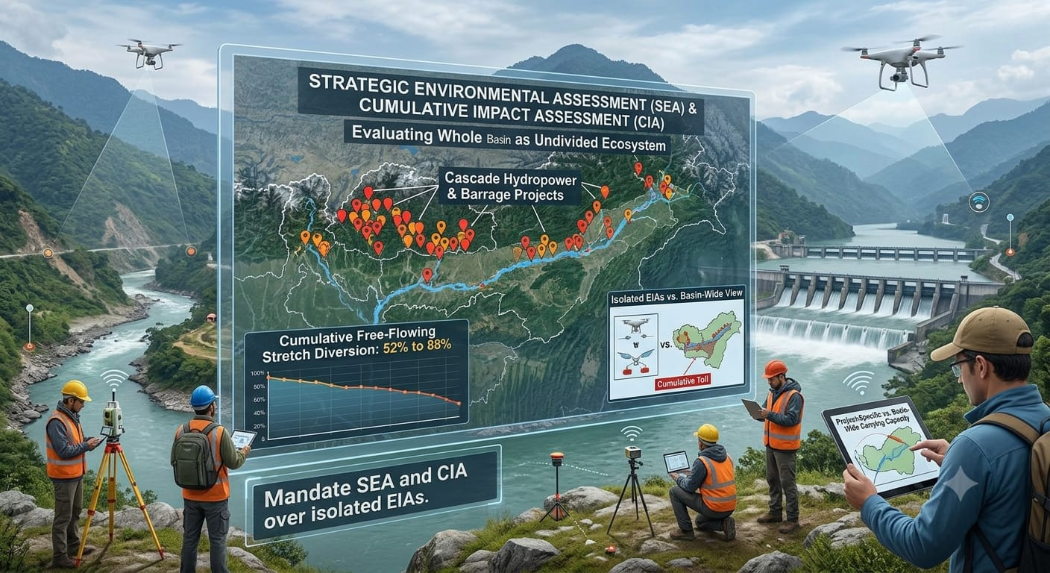
4.2 Operation Phase Impacts
1.Rapid Siltation Risk: Heavy sediment coming from upstream Himalayas could rapidly silt up the narrow channel, necessitating continuous, costly maintenance dredging.
2. Groundwater Depletion: Industrialization on reclaimed land may lead to over-abstraction of groundwater, lowering water tables in surrounding agricultural areas.
3. Char Ecosystem Loss: Permanent channelization will eliminate natural char dynamics, disturbing the riverine food web.

Slide 8
5. Environmental Impact Assessment (EIA) Matrix
Environmental Parameter | Impact Type | Severity | Duration | Spatial Extent
Water Quality & Turbidity | Direct Negative | Moderate to High | Short-term (Construction) | Local & Downstream
Fish Spawning & Habitats | Direct Negative | High | Long-term | River-wide
Hydro-Morphology | Indirect Negative | High | Permanent | Dalia to Chilmari
Agricultural Protection | Direct Positive | Very High | Long-term | 5 Northern Districts
Char Island Ecosystem | Direct Negative | High | Permanent | Project Area

Slide 9
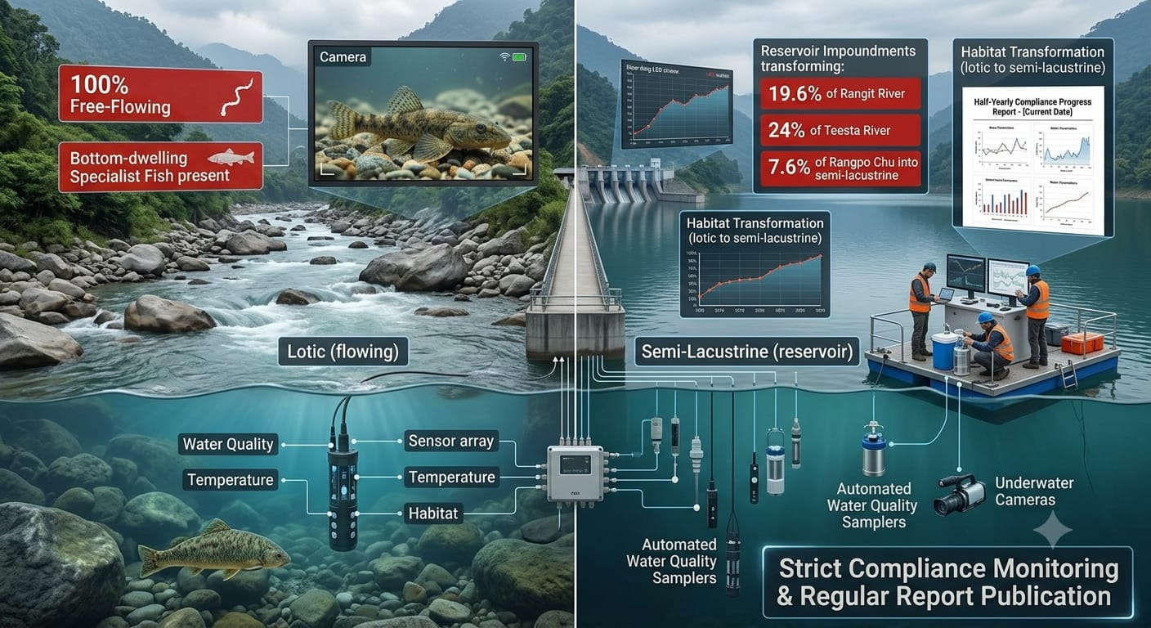
6. Environmental Management Plan (EMP) & Mitigation Measures
A. Pre-Construction Phase
● Advanced Modeling: Conduct comprehensive 2D and 3D numerical hydro-morphological modeling (by BUET or IWM) to simulate flow velocity, scour depth, and sediment transport.
● Seasonal Baselines: Establish seasonal baseline data for surface water quality, heavy metal content, and aquatic diversity.
B. Construction Phase
● Turbidity Control (Silt Curtains): Deploy silt curtains around dredging zones to prevent sediment plumes from spreading downstream.
● Seasonal Suspension: Halt major dredging activities during peak fish breeding months (April to August).
● Bio-Engineering: Integrate bio-engineering techniques (e.g., Vetiver grass planting) along embankments alongside hard revetments (CC blocks/riprap).

Slide 10
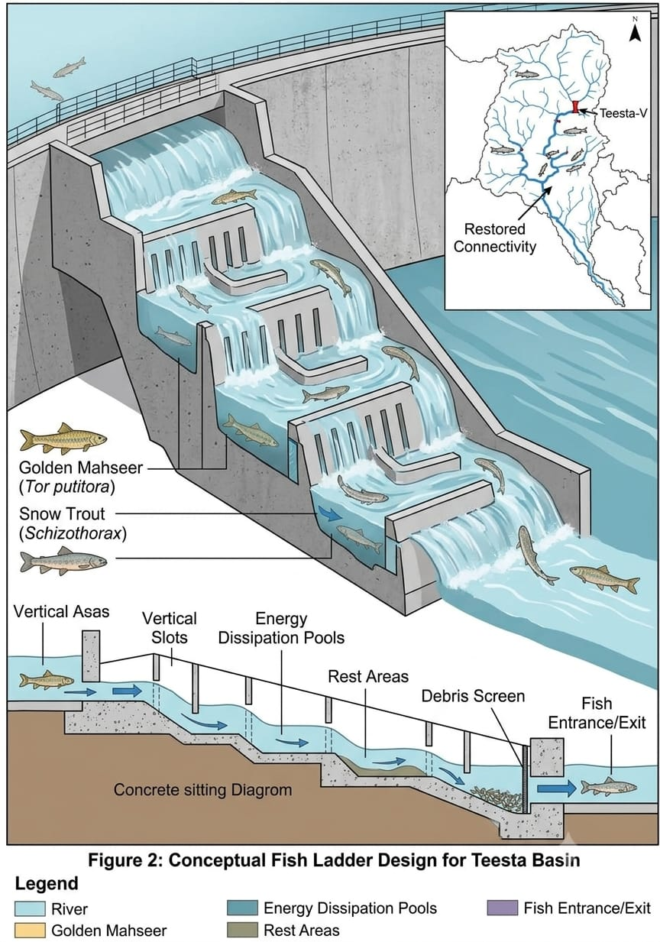
● Sediment Management: Utilize dredged sand/soil for filling reclaimed land only after verifying non-toxicity.
C. Operational Phase
● Fish Passages & Sanctuaries: Construct fish passes or designated sanctuaries around key hydraulic structures to allow migratory fish movement.
● Mandatory Industrial ETPs: Mandate Central Effluent Treatment Plants (CETP) for any industrial zones established on reclaimed land.

Slide 11
7. Environmental Monitoring Framework
Parameter | Key Performance Indicator (KPI) | Frequency | Responsible Agency
Water Quality | pH, DO, BOD, Turbidity, Heavy Metals | Monthly | DoE & IWM
Fisheries & Ecology | Species richness, Gangetic Dolphin sightings | Bi-annually (Pre/Post Monsoon) | Dept. of Fisheries / BFRI
Erosion & Siltation | Bed level profiles, revetment scour depth | Post-Monsoon | BWDB
Socio-Economic | Compensation & Resettlement status | Bi-annually | Independent 3rd Party NGO

Slide 12
8. Conclusion and Policy Recommendations
While the Teesta River Comprehensive Restoration Project offers major flood control and economic opportunities for northern Bangladesh, its long-term viability depends on balancing hard engineering solutions with Nature-based Solutions (NbS). Furthermore, establishing a transparent Resettlement Action Plan (RAP) for char communities and addressing basin-wide transboundary water flows are critical to ensuring environmental and social sustainability.

Slide 13
References
BWDB & PowerChina. (2019). Feasibility Study Report on Teesta River Comprehensive Restoration Project. Bangladesh Water Development Board, Ministry of Water Resources, Dhaka.
Department of Environment (DoE). (1997/2021). EIA Guidelines for Water Sector Projects. Ministry of Environment, Forest and Climate Change, Government of Bangladesh.
IUCN Bangladesh. (2015). Red List of Bangladesh (Vol. 4: Freshwater Fishes). International Union for Conservation of Nature, Dhaka, Bangladesh.
Khalequzzaman, M. (2020). Teesta River Comprehensive Management and Restoration Project: A Preliminary Assessment. 4th International Conference on Bangladesh Environment (ICBEN-4), Dhaka.

Slide 14
THANK YOU
ANY QUESTIONS?

